Slide 1

Project Name:
Early Stage Diabetes
Risk Prediction
Ved Ghuikhedkar
© All rights reserved by Fireblaze Technologies Pvt. Ltd.

Slide 2
Problem Statement
To train a model to predict whether a patient is likely to get a Diabetes based on the input parameters like gender, age, obesity and various other diseases.
© All rights reserved by Fireblaze Technologies Pvt. Ltd.

Slide 3
Proposed Solution
Create machine learning model using classification algorithm such as Logistic Regression, K- Nearest Neighbors Classifier , Decision Tree and Random Forest to predict the person can get Diabetes or not.
© All rights reserved by Fireblaze Technologies Pvt. Ltd.

Slide 4
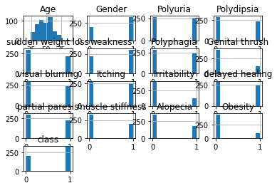
Descriptive Analysis
© All rights reserved by Fireblaze Technologies Pvt. Ltd.

Slide 5
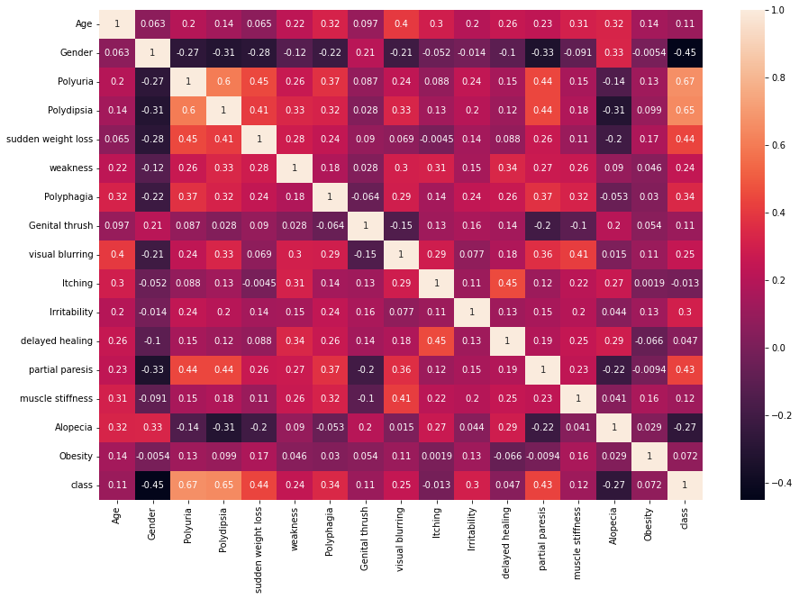
Descriptive Analysis
© All rights reserved by Fireblaze Technologies Pvt. Ltd.

Slide 6
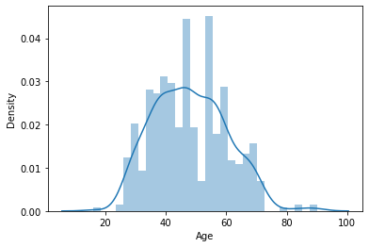
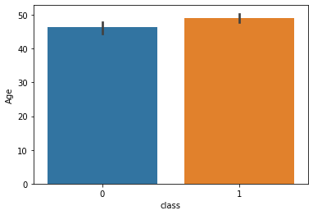
Descriptive Analysis
© All rights reserved by Fireblaze Technologies Pvt. Ltd.

Slide 7
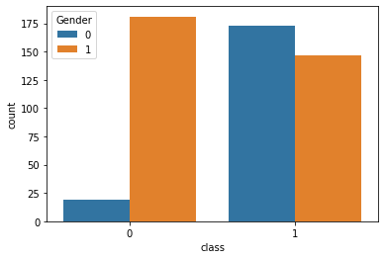
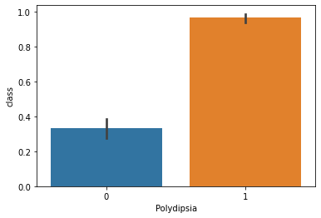
Descriptive Analysis
© All rights reserved by Fireblaze Technologies Pvt. Ltd.

Slide 8
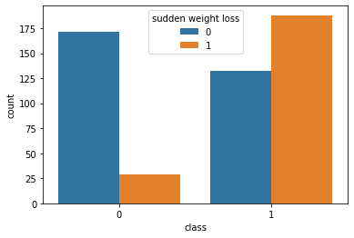
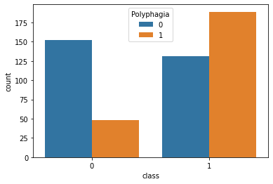
Descriptive Analysis
© All rights reserved by Fireblaze Technologies Pvt. Ltd.

Slide 9
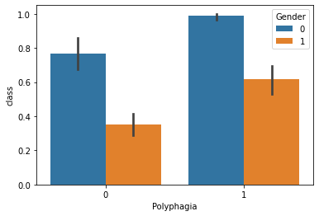
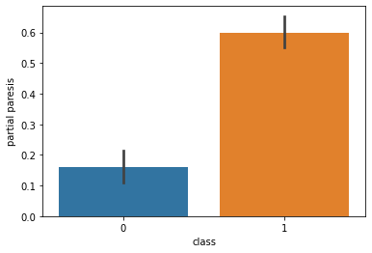
Descriptive Analysis
© All rights reserved by Fireblaze Technologies Pvt. Ltd.

Slide 10
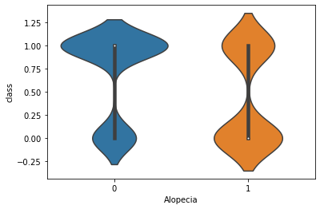
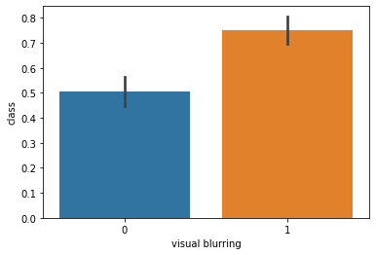
Descriptive Analysis
© All rights reserved by Fireblaze Technologies Pvt. Ltd.

Slide 11
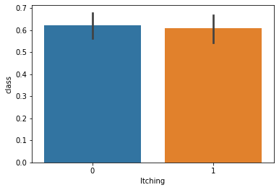
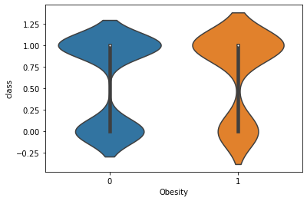
Descriptive Analysis
© All rights reserved by Fireblaze Technologies Pvt. Ltd.

Slide 12
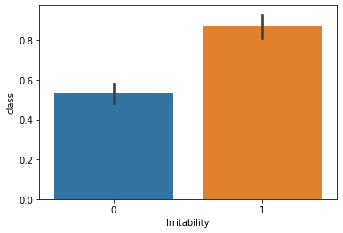
Descriptive Analysis
© All rights reserved by Fireblaze Technologies Pvt. Ltd.

Slide 13
Effect of Data Pre-processing
Pre-processing refers to the transformations applied to our data before feeding it to the algorithm. Data Preprocessing is a technique that is used to convert the raw data into a clean data set. In other words, whenever the data is gathered from different sources it is collected in raw format which is not feasible for the analysis. We need this For achieving better results from the applied model in Machine Learning projects the format of the data has to be in a proper manner.
© All rights reserved by Fireblaze Technologies Pvt. Ltd.

Slide 14
Machine Learning Modelling
A machine learning model is an expression of an algorithm that combs through mountains of data to find patterns or make predictions.
Machine Learning (ML) models are the mathematical engines of artificial intelligence.
A machine learning model has been trained to recognize certain types of patterns. You train a model over a set of data, providing it an algorithm that it can use to reason over and learn from those data
In this we have used various ML models to predict the output such as Logistic Regression, K-Nearest Neighbors (KNN) Classifier, Decision Tree Classifier and Random Forest Classifier.
© All rights reserved by Fireblaze Technologies Pvt. Ltd.

Slide 15
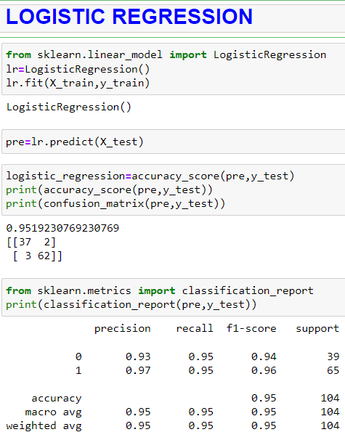
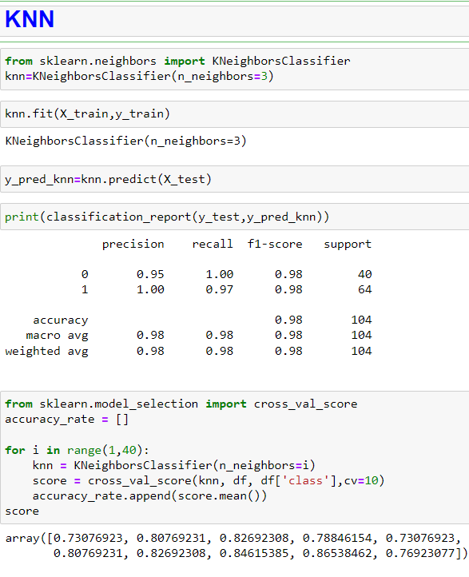
Machine Learning Modelling
© All rights reserved by Fireblaze Technologies Pvt. Ltd.

Slide 16
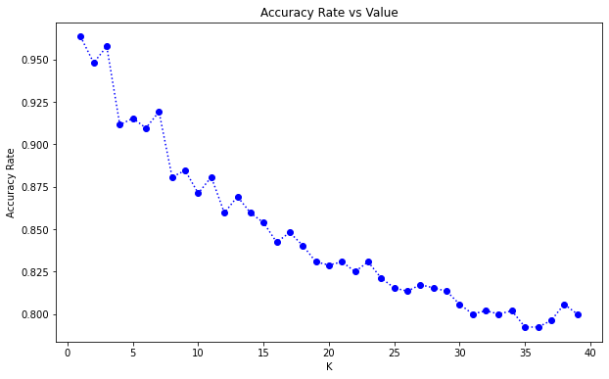
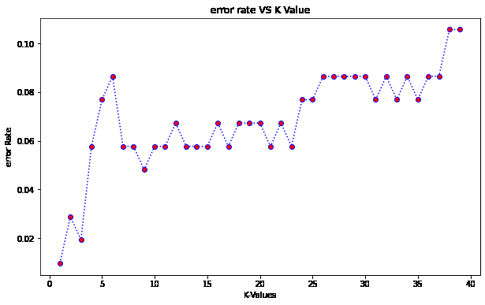
Machine Learning Modelling
© All rights reserved by Fireblaze Technologies Pvt. Ltd.

Slide 17
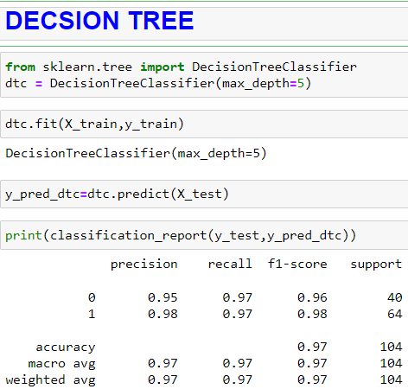
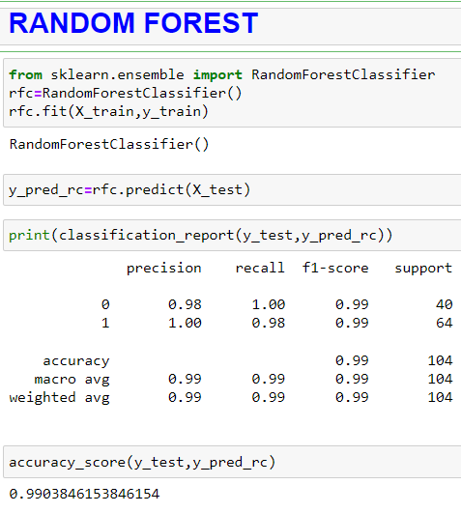
Machine Learning Modelling
© All rights reserved by Fireblaze Technologies Pvt. Ltd.

Slide 18
Conclusion
Our Machine Learning Model is trained to classify that whether a person is will get DIABETES or not from the dataset info which can give insight to the Doctors and Patients as well.
We have Processed and Cleaned our Data using the Missing Data Treatment, Outlier Treatment, Encoding Categorical Data, Splitting Dataset into Training and Testing Set, Feature Scaling, and all the required steps, after that we have trained our model.
Here ML Models are used such as Logistic Regression, K- Nearest Neighbors Classifier, Decision Tree and Random Forest.
To get max accuracy score we have trained and tested our prediction model. The accuracy of the model is determined using Accuracy score which gave the output of over 95%.
Logistic Regression - 0.95 K- Nearest Neighbors Classifier - 0.98
Decision Tree - 0.97 Random Forest - 0.99
© All rights reserved by Fireblaze Technologies Pvt. Ltd.

Slide 19
Future Scope
DIABETES is dependent on the lifestyle attributes as well as past medical condition which we have considered in this ML Model.
In the future, for better performance of the model more medical attributes can be considered such as The min, max and mean value of obesity.
The IDRS score can be added to get a more accurate and precise output.
The Indian Diabetes Risk Score (IDRS) predicts the probability of diabetes based on four simple parameters— age, abdominal obesity, family history of diabetes, and physical activity. A maximum score of 100 is given for these categories combined.
© All rights reserved by Fireblaze Technologies Pvt. Ltd.

